Slide 1


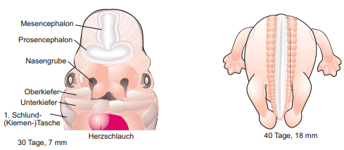

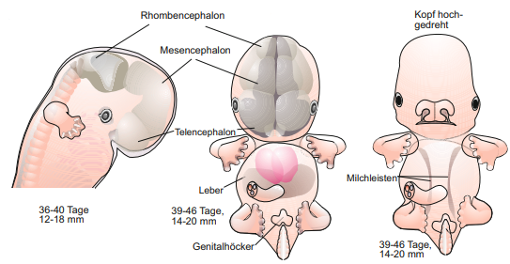


Biological background
2. Embryonic development
Entwicklungs- und Reproduktionsbiologie
Müller 2018
Our dataset targets week 4 to 9 of embryonic development
Notes:
It’s a quite interesting issue how a complex multicellular organism develops from a single cell. Our dataset targets week 4 to 9. Especially the brain develops
At week 4: the neural tube closes and the heart starts to beat and first structures like arm buds develop.
The brain of the fetus grows during the next weeks and the Prosencephalon develops to the Diencephalon and Telencephalon. Furthermore the morphology of the embryo changes.
Major parts of the brain are developed at week 9.
Many signals influence the development of the brain e.g. chemokines.

Slide 2
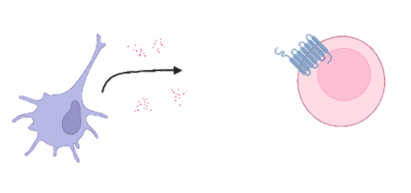
Biological background
3. Chemokines
Groupe of small similar proteins
chemoattractors
Bind to G-Protein coupled receptors (GPCR) → induce signaling cascade
Notes:
But what are chemokines ?
Small groupe of proteins with similar structure.
Chemoattractors: -> cells (dendritic cells) rerlease them, effector cells (leukocytes) move to the origin of release
->chemokines bind to GPCR and induce signaling cascade
They play an important role in embryonic development, which is unknown.

Slide 3
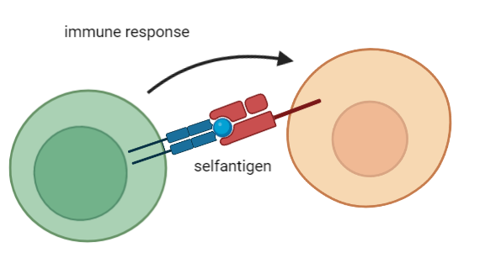
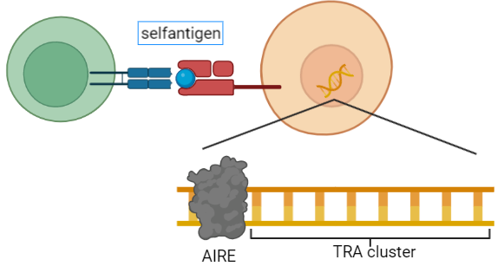
Biological background
4. Tissue restricted antigens (TRAs)
Genes for Self-antigens → essential for functional immune cells
Genes which are more than 5x than the median in less than 5 tissues expressed
Ordered in Autoimmune Regulator (AIRE) controlled cluster
Notes:
Another important issue are TRAs
Functional immune cells are necasssary to prevent infections
Shouldn’t react against selfantigens -> negative control in thymus
Medullary thymic epithelial cells (mTECs) present slef-antigens on their surface, reacting immune cell will be removed
Tissue restricted antigens (TRAs) code for selfantigens
Genes more than 5x the median in less than 5 diffrent tissues expressed
TRAs are ordered in cluster which are controlled by the transcriptionfactor Autoimmune Regulator (AIRE)

Slide 4
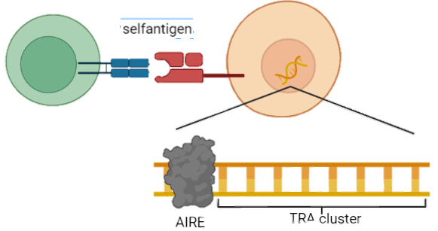
Biological background
4. Tissue restricted antigens (TRAs)
Genes for Self-antigens → essential for functional immune cells
Genes which are more than 5x than the median in less than 5 tissues expressed
Ordered in Autoimmune Regulator (AIRE) controlled cluster
Notes:
Another important issue are TRAs
Functional immune cells are necasssary to prevent infections
Shouldn’t react against selfantigens -> negative control in thymus
Medullary thymic epithelial cells (mTECs) present slef-antigens on their surface, reacting immune cell will be removed
Tissue restricted antigens (TRAs) code for selfantigens
Genes more than 5x the median in less than 5 diffrent tissues expressed
TRAs are ordered in cluster which are controlled by the transcriptionfactor Autoimmune Regulator (AIRE)

Slide 5
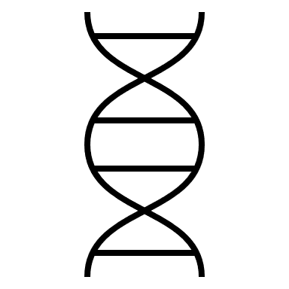

Dataset

Slide 6
Dataset

Slide 7
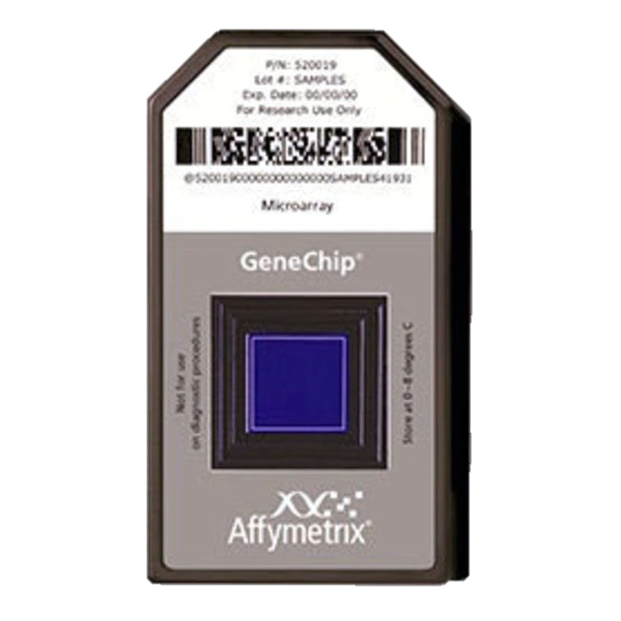
Quality control (QC)
Affymetrix Human Genome U133 Plus 2.0 Array
Expression analysis of over 47,000 transcripts and variants through comparison of 54 000 probe sets
detection sensitivity 1:100,000
Gen sequences of probe sets are selected from GenBank®, dbEST, and RefSeq
complementary oligonucleotide probes are synthesized in situ on the array
www.thermofisher.com/
Notes:
Before we start to investigate the quality of our acquisition, I am going to intoduce our microarray.
Our dataset was obtained by the affymetrix human genome U133 Plus 2.0 Array, which analysis the expression data of over 47,000 transcripts and variants and has a sensitivity of 1 transcriptome in a 1000 according to the technical sheet.
The relevent gen sequences were selected from GenBank, dbest and RefSeq and complementary oligonucleotide probes are synthesized in situ on the array

Slide 8
Quality control
1. Array surface images
No spatial artefacts
Slight difference in overall intensity

Slide 9
Dataset Intensity histograms

Slide 10
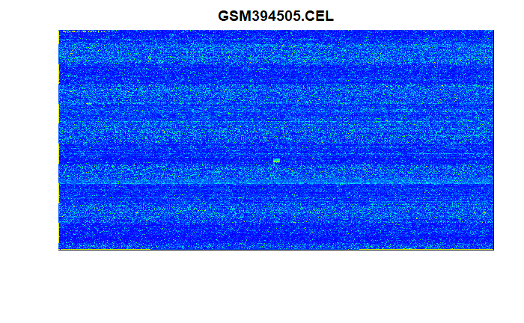
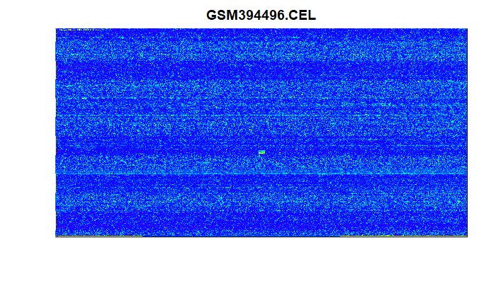
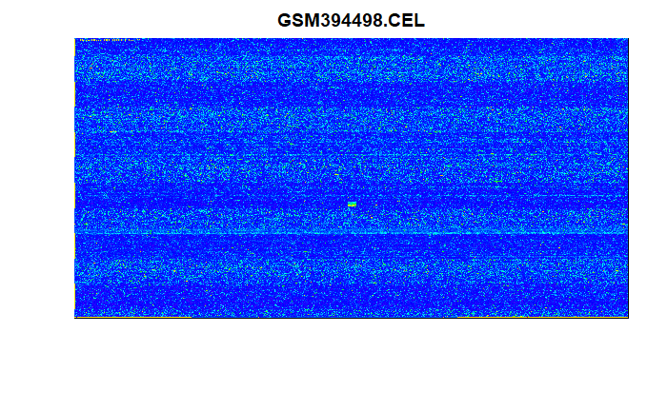
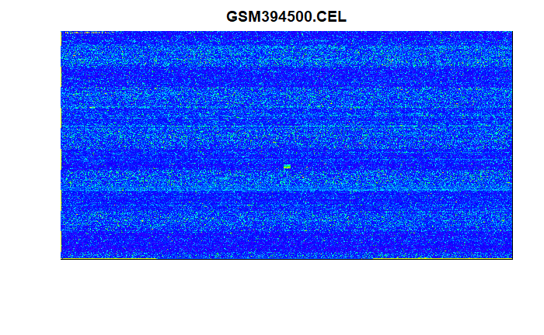
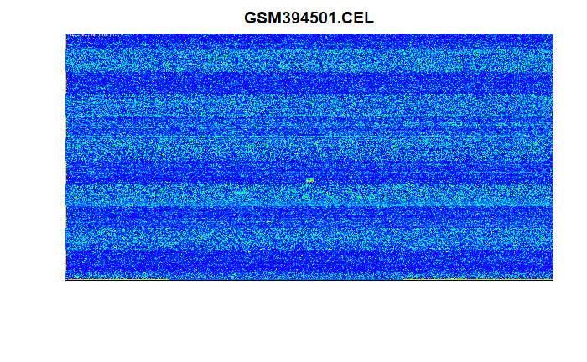



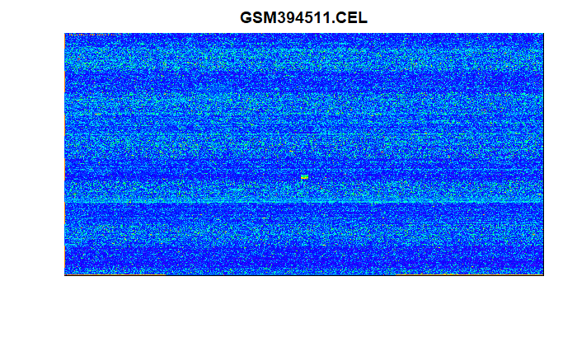
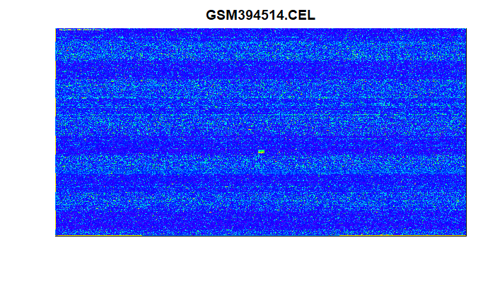
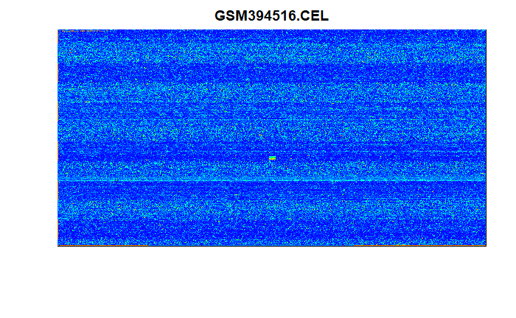
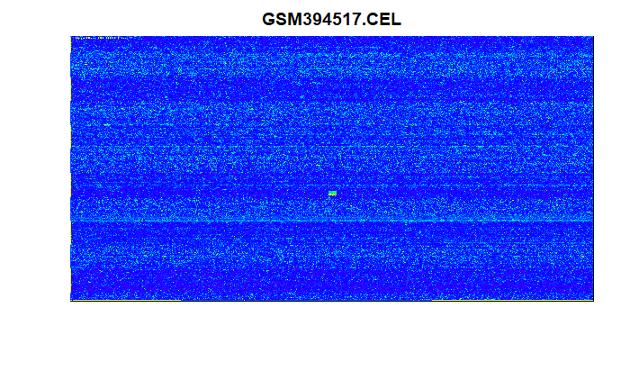
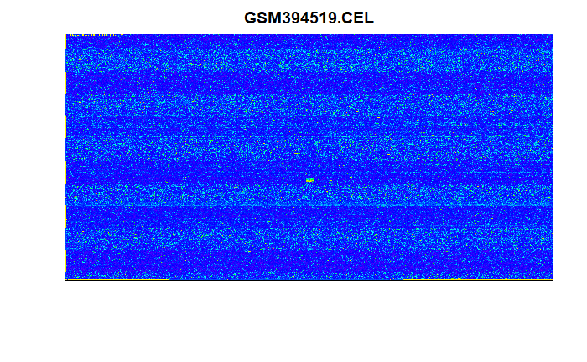

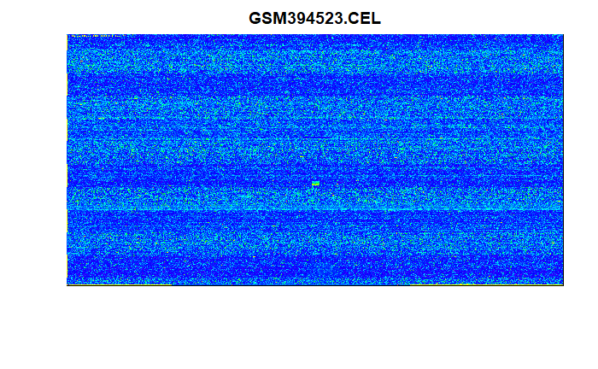
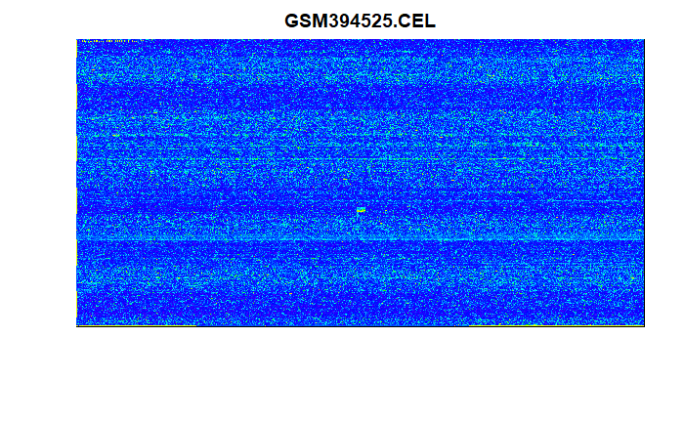


1. Array surface images (QC)
No spatial artefacts, fingerprints, irregular dye or stripes
slight differences in overall expression detection
Notes:
Starting with the Quality control, we can first observe the surface images of the array. On the 18 chips we can see no spatial artefacts, no fingerprints, no irregular dye or stripes. We can detect slight differences in overall expression detection though, for example if we compare Microarray 12 with 17. This however is still in its boundarys and should be corrected after our normalization.

Slide 11
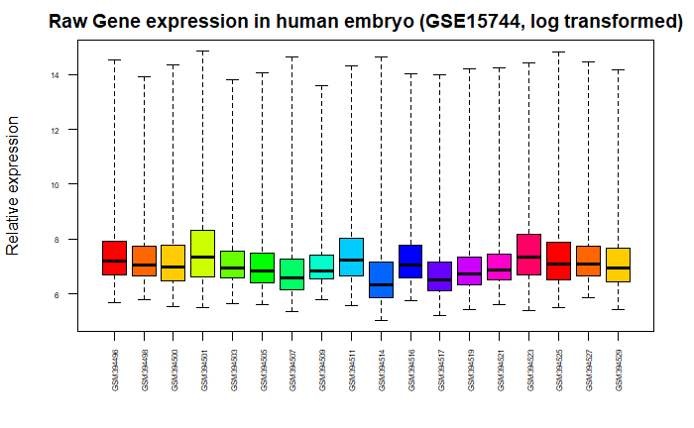
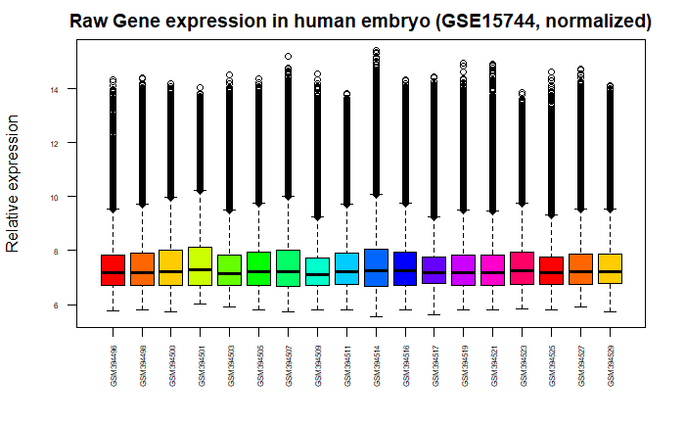
2. Expression boxplot vsnrma normalized (QC)
All chips in similar range after normalization
All 18 chips accepted
Notes:
Next up we got our boxplots which confirm that we can normalize our data by variance stabilization and the robust multichip average. These deal with systematic errors and random fluctuation and give us comparable results. These boxplots show us, that we do not need to eliminate an unfitting chip.

Slide 12
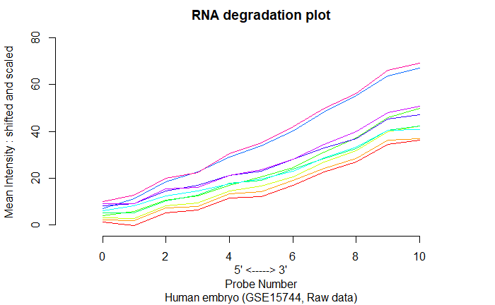
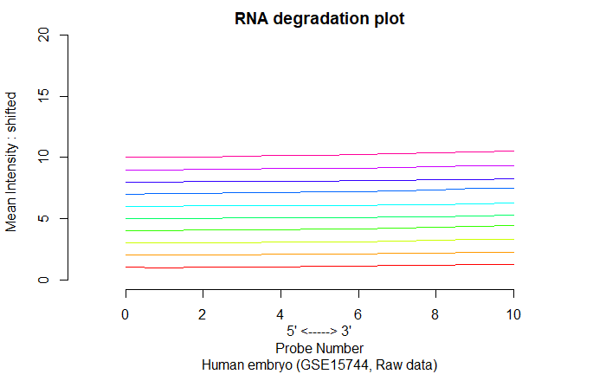
Quality control
3. RNA degradation plots
Similar distribution in RNA degradation in all chips
All 18 chips accepted
Notes:
Next up we got our RNA degradation. The RNA bound to the surface and is an unstable molecule that degradates. This is no problem for statistics as long as the degradation happens at the same time on each microarray.

Slide 13
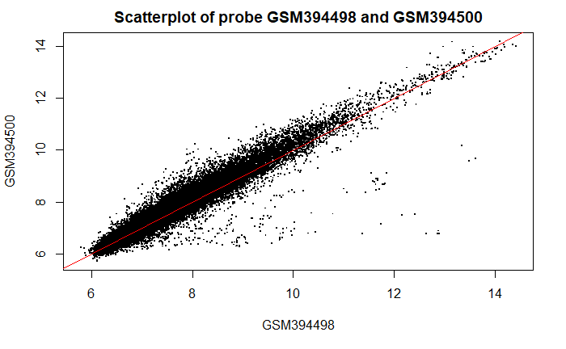
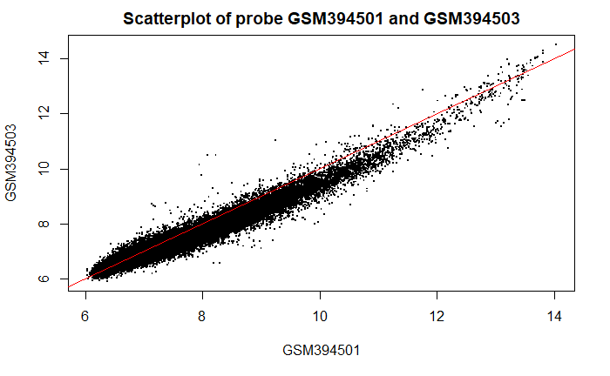
Quality control
4. Scatterplots
Similar distribution in RNA degradation in all chips
All 18 chips accepted
week 1, rep 2 and rep3
week 5, rep 1 and rep2

Slide 14

Milestones/Timeline

Slide 15
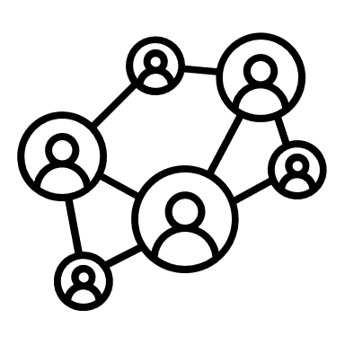





Teamwork
Staying connected
WhatsApp as main tool of communication
Tracking Progress
Log each meeting via Google Docs to keep overview of to-dos and topics
Tutorial Debriefing
Asses tutorial and collect immediate thoughts
Round Table/Mind Meld/Building the Base
Tuesday 5 pm, in-depth discussion of tutorial and setting this weeks tasks
Keeping it flexible
Remote meetings via Discord when needed

Slide 16
Biological background
1. Biological thesis
How do TRAs influence embryonic development ?
Do TRAs influence the development of the CNS during week 4 to 9 ?
Are chemokines or their receptors presented in this developmental stage ?
Notes:
TRAs are meant to play an important role in embryogenesis, therefor we’ll investigate: How do TRAs influence embryonic development ?
Furthermore we’ll try to figure out, if TRAs influence the development of CNS during week 4 to 9. In addition we’ll try to identify the role of chemokines for the CNS in this period.

Slide 17
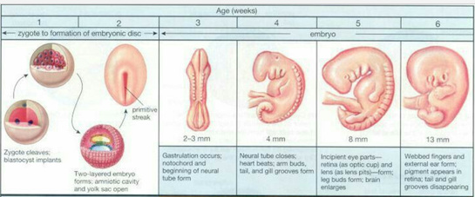
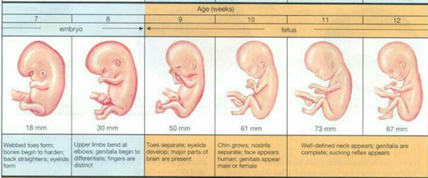
Biological background- Supplementary
1. Embryonic development
https://www.pinterest.de/supermamame/fetus-week-by-week/

Slide 18
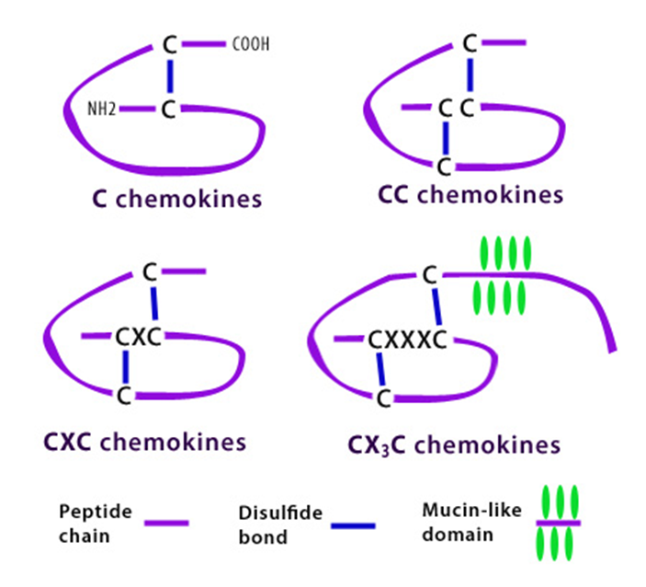
Biological background- Supplementary
2. Classes of chemokines
https://www.biolegend.com/chemokine_receptors

Slide 20
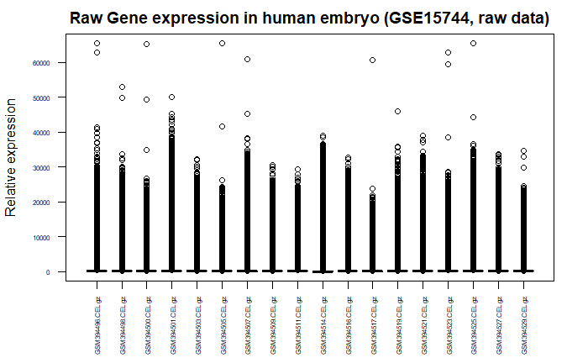
2. Expression boxplot vsnrma normalized (QC)

